Slide 1
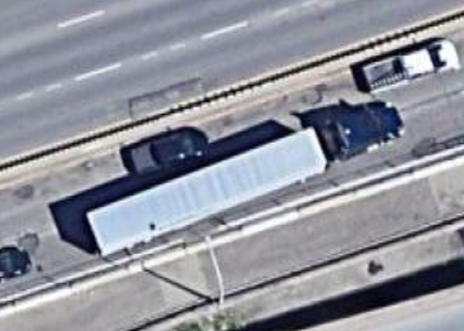
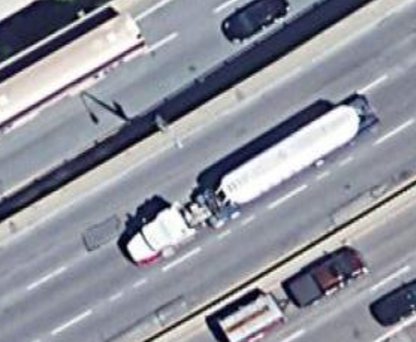
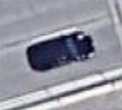
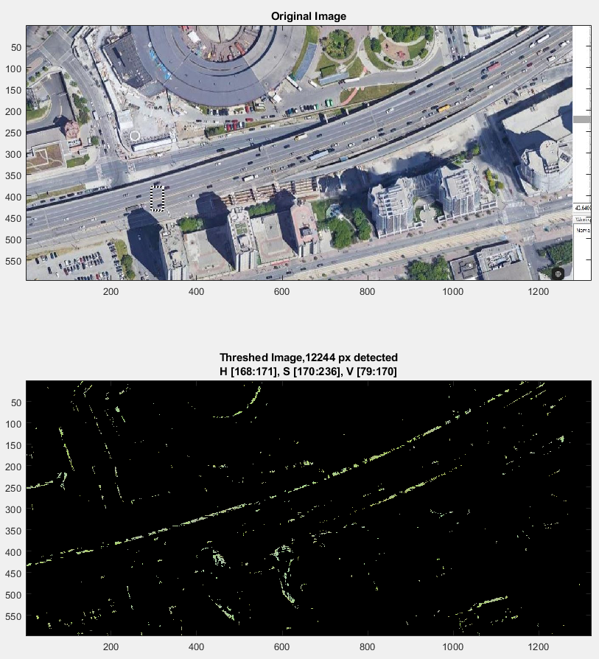
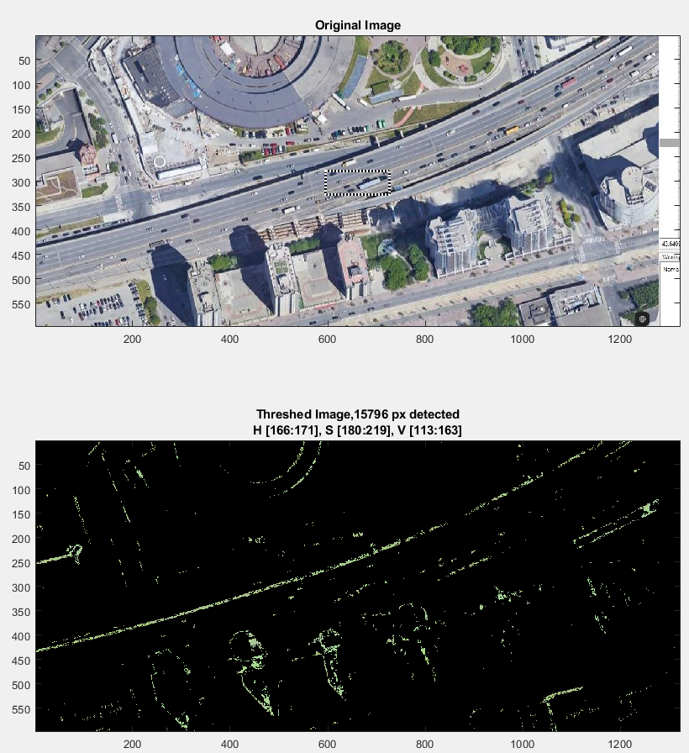
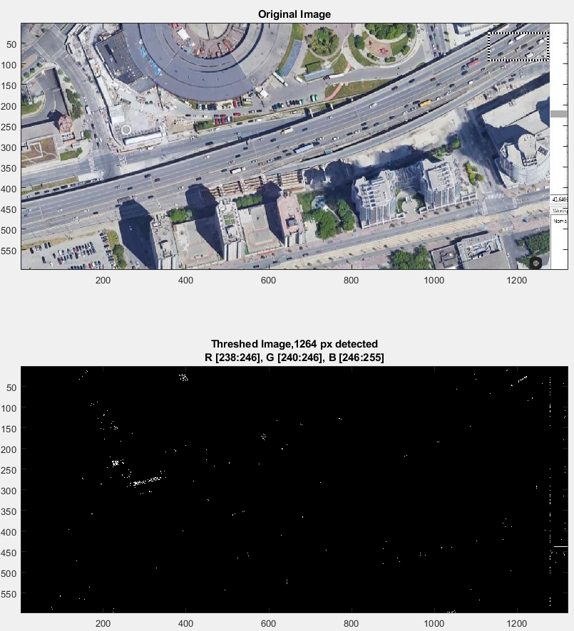
Colour Threshold
Notes:
Matlab tool
Vehicles have a large range of colours
difficult to distinguish all of them from the environment
difficult to detect as an object

Slide 2
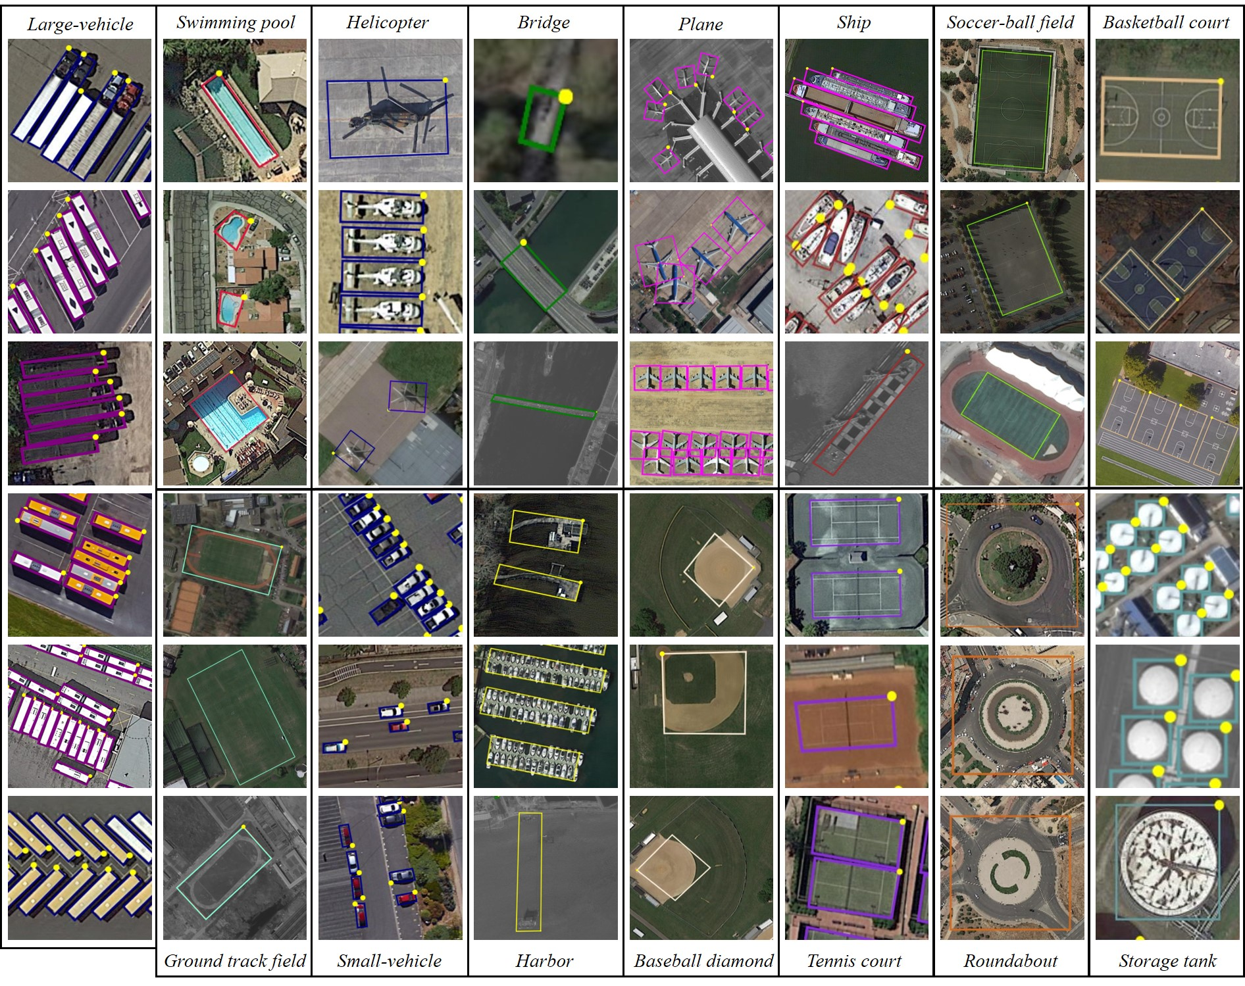
DOTA: A Large-scale Dataset for Object Detection in Aerial Images
Model: Faster R-CNN
15 classes including small vehicles and large vehicles
Pre-trained model:
2806 aerial images
800 * 800 to 4000 * 4000 pixels
188,282 instances
Notes:
Deep learning model trained with an annotated dataset named DOTA
It includes vehicles
the training images fit to Google maps scenes

Slide 3

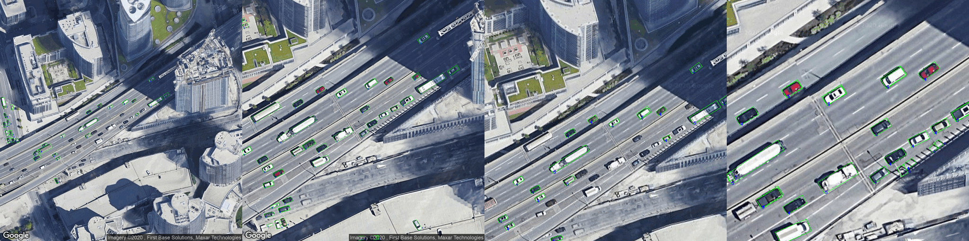
Comparison on images with different dimensions
width*height: 512*512
Scale: 2
Zoom: 18
width*height: 512*512
Scale: 2
Zoom: 19
width*height: 1024*1024
Scale: 1
Zoom: 19
width*height: 1024*1024
Scale: 1
Zoom: 20
Notes:
Applied model to 4 dimensions
1st and 3rd images are too small to detect small and dark cars
4th image is too large so that some objects are detected as cars like the shadows, the white lines

Slide 4
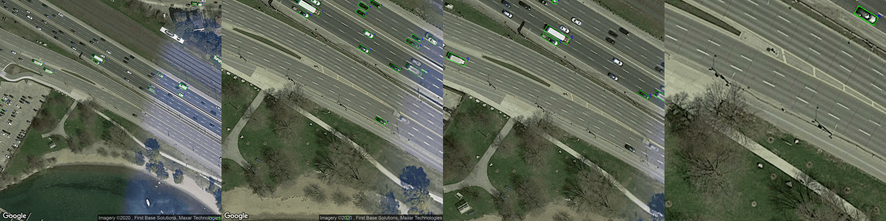
width*height: 512*512
Scale: 2
Zoom: 18
width*height: 512*512
Scale: 2
Zoom: 19
width*height: 1024*1024
Scale: 1
Zoom: 19
width*height: 1024*1024
Scale: 1
Zoom: 20

Slide 5
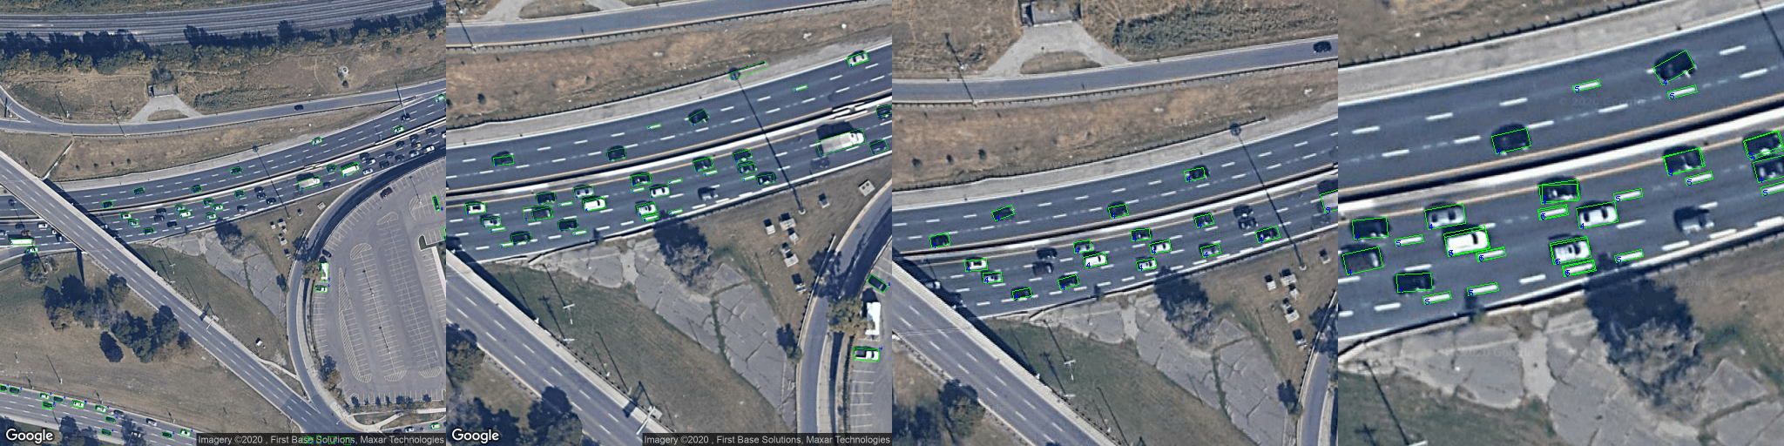
width*height: 512*512
Scale: 2
Zoom: 18
width*height: 512*512
Scale: 2
Zoom: 19
width*height: 1024*1024
Scale: 1
Zoom: 19
width*height: 1024*1024
Scale: 1
Zoom: 20

Slide 6
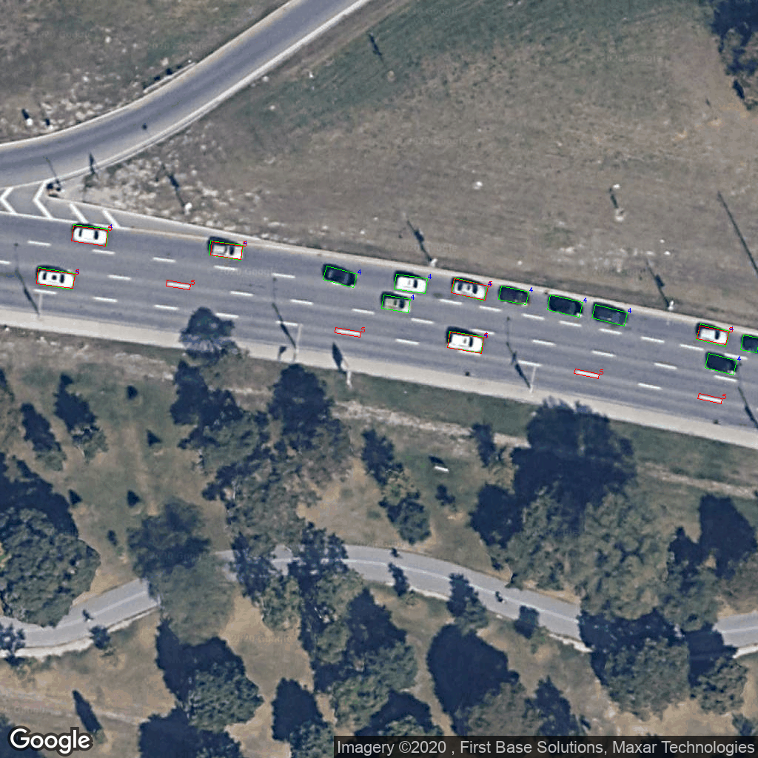
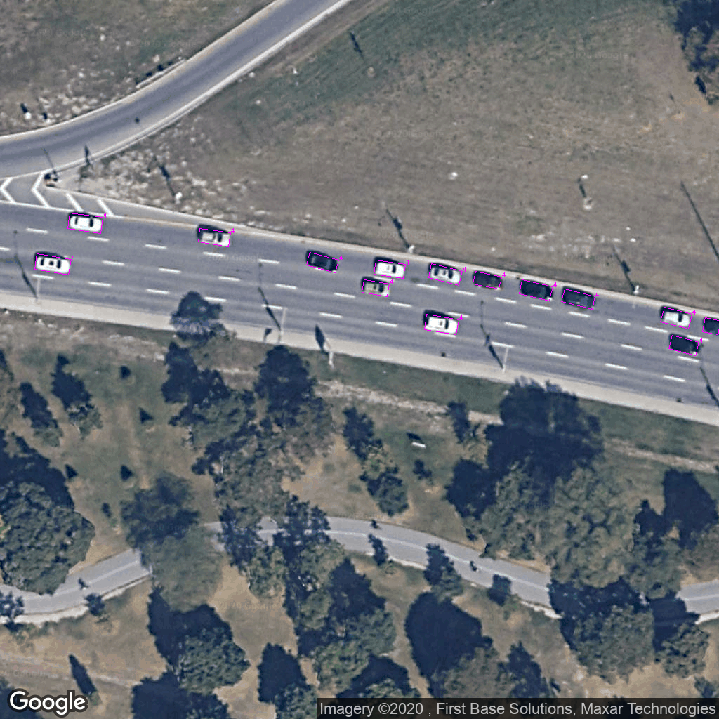
Improvement
Mislabelled objects
Detected twice

Slide 7
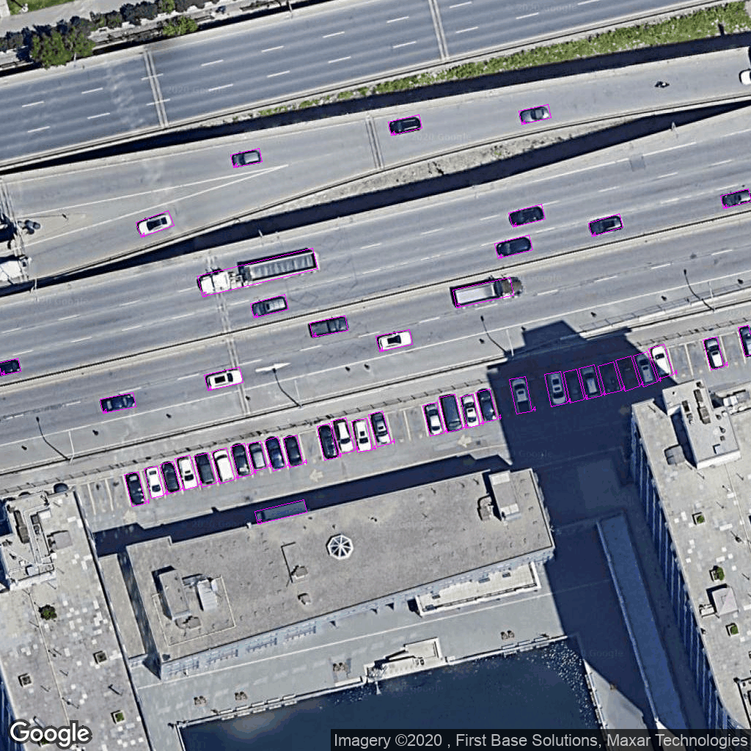
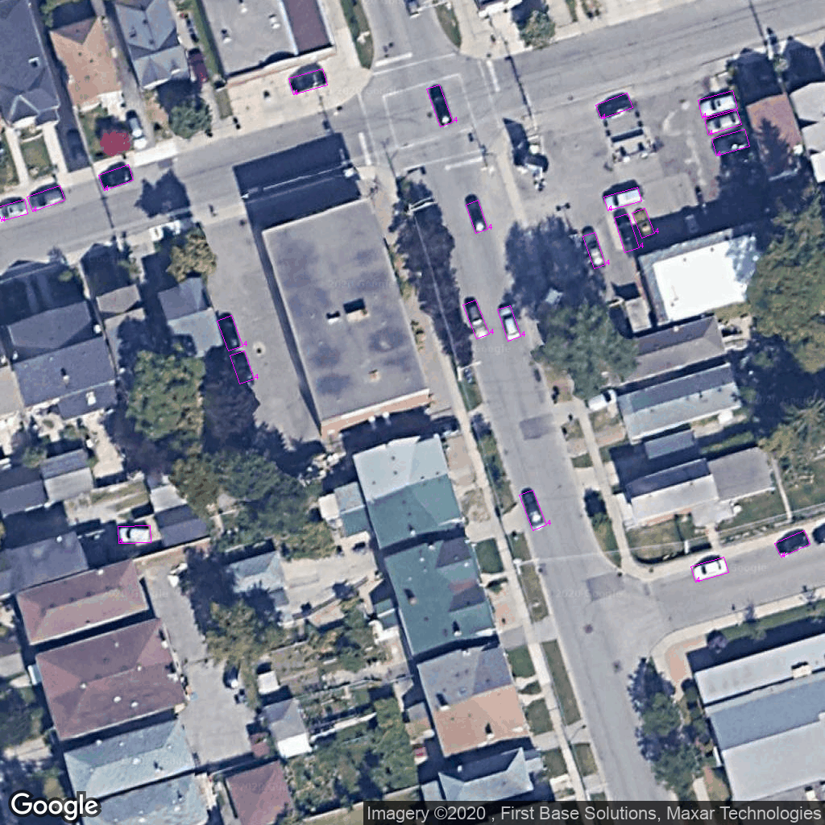
Next step: Road Detection
Estimate road length
Drop off-road vehicles
Drop parked vehicles

